Slide 1
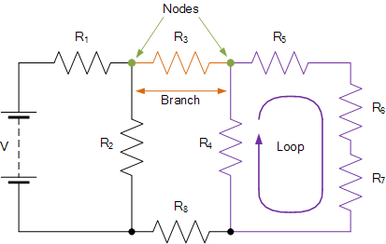
Some Definitions
• Circuit – a closed loop conducting path in which an electrical current flows.
• Path – single line of connecting elements or sources.
• Node – a node is a junction, connection or terminal within a circuit were two or more circuit elements are connected or joined together giving a connection point between two or more branches. A node is indicated by a dot.
• Branch – a branch is a single or group of components such as resistors or a source which are connected between two nodes.
• Loop – a loop is a simple closed path in a circuit in which no circuit element or node is encountered more than once.

Slide 2
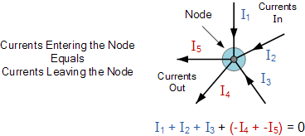
Kirchhoff's First Law – The Current Law, (KCL)
At any node (junction) in an electrical circuit, the sum of currents flowing into that node is equal to the sum of currents flowing out of that node

Slide 3
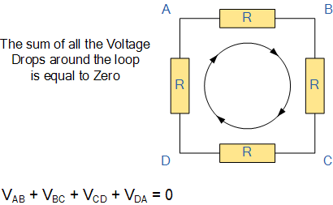
Kirchhoff's Second Law – The Voltage Law, (KVL)
in any closed loop network, the total voltage around the loop is equal to the sum of all the voltage drops within the same loop

